Slide 1
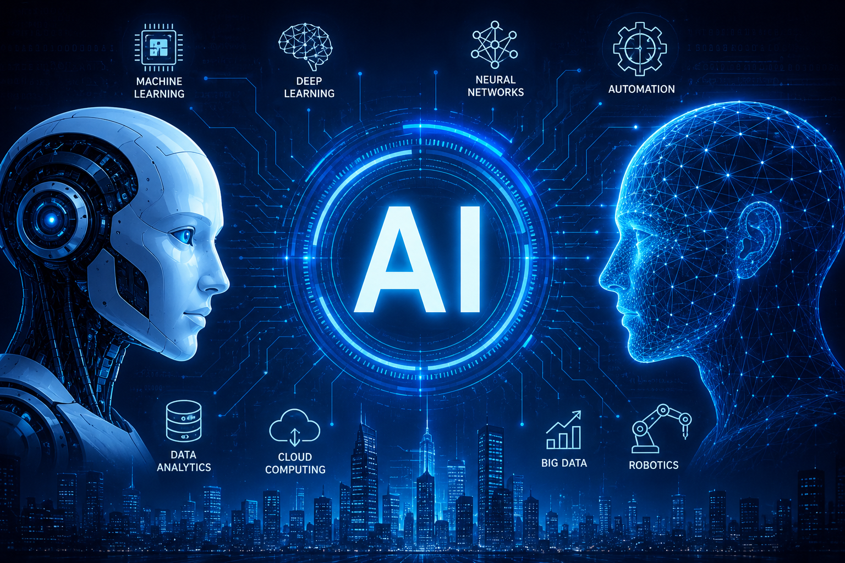
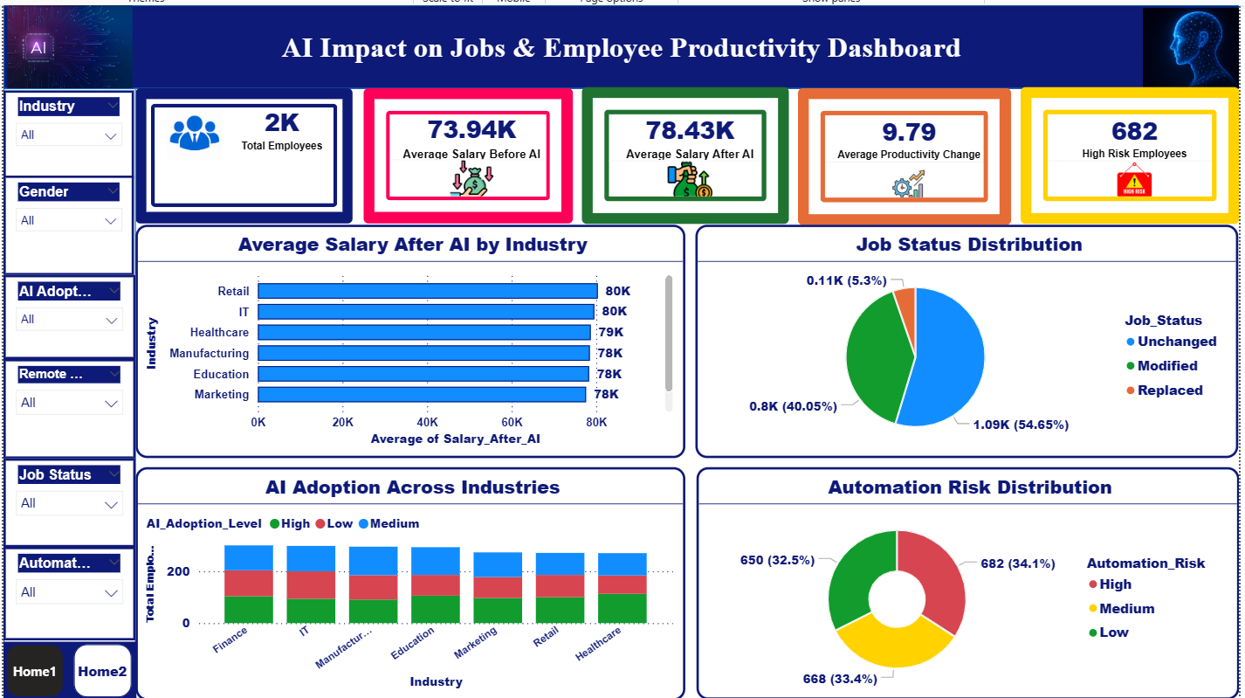
AI IMPACT ON JOBS & EMPLOYEE PRODUCTIVITY
This project analyzes the impact of Artificial Intelligence on job roles,workforce trends, employee productivity, salaries, and automation risks across different industries.
Dinukrishna.a
11-May-2026

Slide 2
Agenda
1.Project Objective
2.Project Domain
3.Problem Statement
4.Dataset Overview
5.Data Cleaning Process
6.Calculated Measures
7.Power BI Dashboard Explanation
8.Admin Dashboard Insights
9.User Detail Page Explanation
10.Key Insights
11.Conclusion

Slide 3
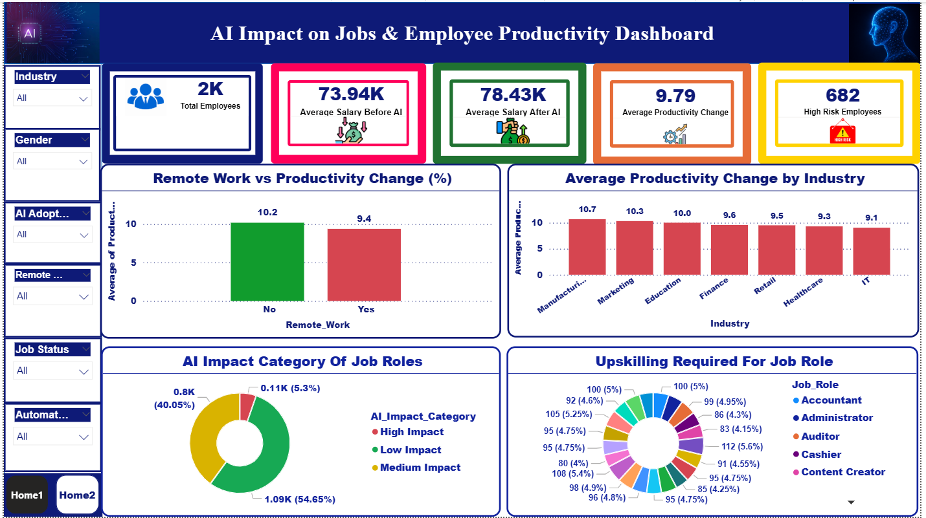
Project Objective
• Analyze the impact of Artificial Intelligence on jobs and workforce trends.
• Study salary changes, automation risk, productivity, and job satisfaction.
• Build interactive dashboards using Power BI.
• Generate insights for workforce decision-making.

Slide 4
Project Domain
Domain: Human Resources (HR) & Workforce Analytics
The project focuses on workforce transformation caused by Artificial Intelligence across industries, analyzing employee data, salary trends, productivity, and automation risk.

Slide 5
Problem Statement
This project identifies:
•Rapid AI adoption is transforming industries and workforce operations.
•Organizations face uncertainty about how AI affects jobs and employee roles.
•Automation increases the risk of job replacement in repetitive tasks.
•Businesses need to understand the impact of AI on salaries and productivity.
• Employee upskilling and workforce adaptation have become essential.
• There is a need for data-driven insights to support strategic workforce decisions.

Slide 6
Dataset Overview
Dataset: AI Job Impact Dataset
• 2000+ Records
• 17 Features/Columns
• Combination of Numerical & Categorical Data
Key Columns:
Employee_ID, Industry, Job_Role, AI_Adoption_Level,
Automation_Risk, Salary_Before_AI, Salary_After_AI,
Productivity_Change_%, Job_Satisfaction

Slide 7
Data Cleaning Process
Data preprocessing was performed using Microsoft Excel.
• Removed duplicate records
• Handled missing values
• Standardized text & number formats
• Applied filters and sorting
• Created calculated fields
• Generated Pivot Tables for analysis

Slide 8
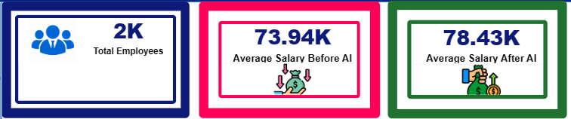
Calculated Measures
Excel Calculated Columns:
• Salary Change
• Salary Change %
• Experience Level
• AI Impact Category
Power BI DAX Measures:
• Total Employees
• Average Salary Before AI
• Average Salary After AI
• Average Productivity Change
• Average Job Satisfaction

Slide 9
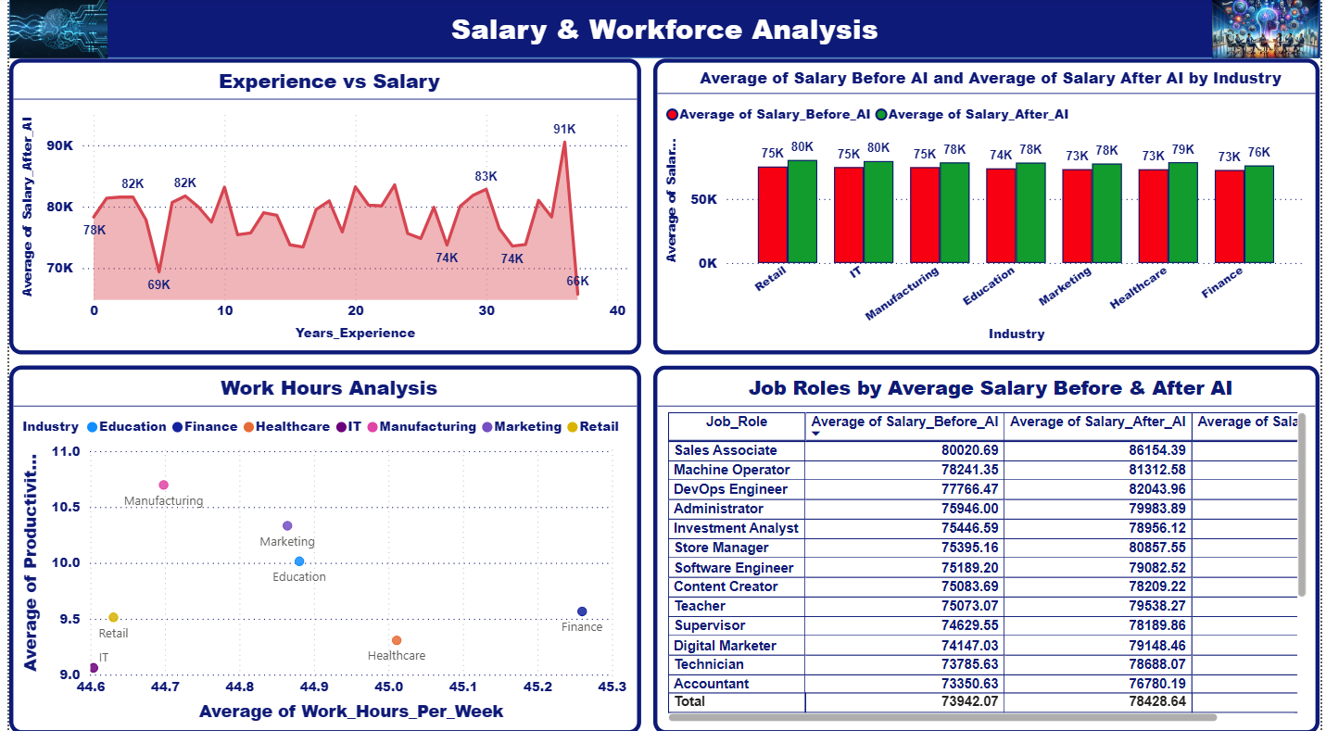
Power BI Dashboard
The dashboard provides interactive workforce analytics using:
• KPI Cards
• Bar & Column Charts
• Pie & Donut Charts
• Line Chart
• Scatter Plot
• Table
• Interactive Slicers

Slide 10
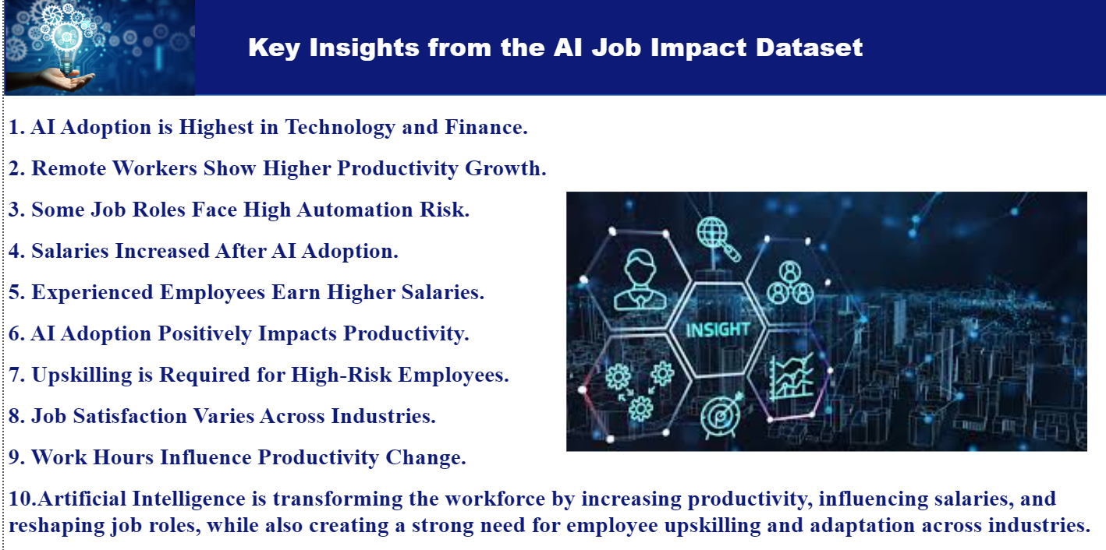
Admin Dashboard Insights
The Admin Dashboard provides high-level organizational insights.
• Total Employees & Salary KPIs
• AI Adoption Across Industries
• Automation Risk Distribution
• Productivity Impact Analysis
• Job Status Distribution
Helps management make strategic workforce decisions.

Slide 11
User Detail Page
The User Detail Page allows detailed employee-level analysis.
• Employee demographics
• Experience and salary comparison
• Job satisfaction tracking
• Remote work productivity analysis
• AI adoption and automation risk evaluation

Slide 12


Key Insights
• Technology and Finance industries show the highest AI adoption.
• Remote workers demonstrate higher productivity improvement.
• AI impacts jobs more through modification than replacement.
• Repetitive job roles face higher automation risk.
• Experienced employees receive higher salaries after AI adoption.
• Upskilling is essential in high-risk industries.

Slide 13
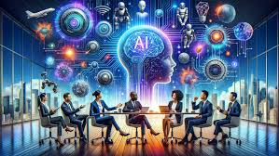
Conclusion
Artificial Intelligence is transforming workforce operations by increasing productivity and reshaping job roles.
This project demonstrates how Excel and Power BI can be used together to analyze AI-driven workforce trends and support data-driven business decisions.
Thank You

